Slide 1
Quantitative Analysis & Critical Thinking Happy Partnership or Major Mismatch?
R. Garner, DePaul University

Slide 2
Positivism vs. Dialectical Thinking
Positivism has come to mean the naïve belief in facts that are fixed (or static) and not contradictory or ambiguous.
Understanding reality dialectically: “facts” are somewhat constructed; they are “factual” for only limited amounts of time; they may contain contradictions.
Critical realism.

Slide 3
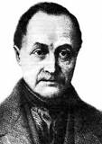

Historical background
Auguste Comte
(Positivism)
Georg Hegel
(Dialectical Thinking)

Slide 4
Data is produced
Understanding data production: facts are produced or constructed—they are grounded in empirical reality—but we do not just “find” or “collect” them. Our intellectual practice produces some facts and not others.
These choices emerge from our theoretical knowledge and our political aims.

Slide 5
Objectivity
Reality has an objective existence, beyond our subjective grasp of it…but how we understand it has a subjective component. We “create facts” by our research, rather than just collect or uncover them.
All research is “biased”—at what steps in the process is that OK and at what steps is it damaging?

Slide 6
Good research questions and falsifiable hypotheses
It is more difficult to find surprising results and to falsify a hypothesis in qualitative than in quantitative research.
The “apparatus” of quantitative research (hypotheses, data analysis, significance tests and confidence intervals, etc.) guards against us always finding what we think is there.

Slide 7
Constructing variables, constructing facts?
Defining variables: we construct ways of going from conceptual variables to operational variables and then measuring these variables accordingly. These definitions and metrics are not “in nature.”
Are they valid and reliable?

Slide 8
Creating categories
Deconstructing categories: we recognize that we are the ones who produce and name the categories of variables.

Slide 9
Causation
We recognize the complexity of causation.
What is causation—what do we mean by “A causes B”?
Multiple causation (many factors “cause” an outcome, operating together).
Statistical determination—A increases the probability of B, but the result is not certain.

Slide 10
Thinking structurally
Place/organization-level analysis and hierarchical models of causation—individual and place/organization levels—e.g., good school performance is “caused” by family, neighborhood, school, etc.
Thus, we avoid faulty “psychologism” that “everything is up to the individual.” Instead, we begin to see structural effects that operate regardless of the individual.

Slide 11
History and historical context
The role of history and historical context: How long is a “fact a fact”? Facts are not fixed but change over time.
(An issue for “Big Data”—how long will these predictions last? They are not good for all times and places.)

Slide 12
Evidence 1
Quantitative analysis dispels stereotypes and replaces anecdotal “evidence” with more complete and systematic information.

Slide 13
Evidence 2
What constitutes evidence? (Statistical inference and tests of significance are part of this process.)
When are we satisfied that we have an “evidence-based conclusion”?

Slide 14
An aesthetic dimension that contributes to understanding
Quantitative analysis encourages the visual display of information and calls for data presentation that is both clear and attractive.
We are encouraged to balance attention to detail with an overview of the “big picture.”
(Edward Tufte on the 1986 Challenger launch decision and disaster)

Slide 15
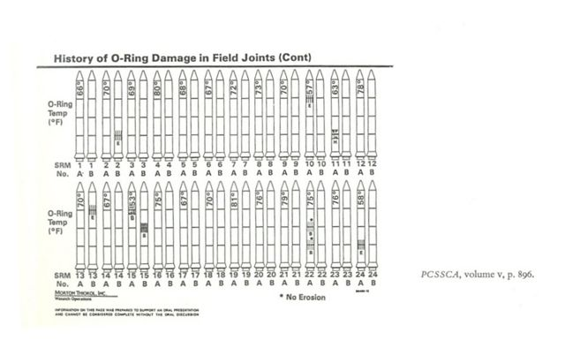
Graphs (Tufte)
Display 1: The actual chart

Slide 16
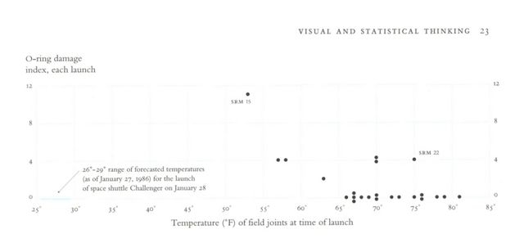
Graphs (Tufte)
Display 2: O-ring damage as a function of temperature

Slide 17
Analysis vs. Power
In this example (the Challenger launch decision) bad analysis and faulty data presentation “left the door open” for political pressures (from the Reagan administration).

Slide 18
The uses of data
What is this finding good for? Whom does it serve? (Only the rich and powerful?) Does it support a policy or a course of action? Does it show the limits of the possible or does it inspire us to expand those limits?
Weber and “inconvenient facts” vs. Marx and “praxis.” Inconvenient facts can be changed by praxis. They are not factual forever, but only in a specific historical context.

